Slide 1
Hypothesis Testing

Slide 2
Hypothesis testing is a procedure for making inferences about a population.
Hypothesis testing allows us to determine whether enough statistical evidence exists to conclude that a belief (i.e. hypothesis) about a parameter is supported by the data.

Slide 3
Non statistical Hypothesis Testing…
A criminal trial is an example of hypothesis testing without the statistics.
In a trial a jury must decide between two hypotheses. The null hypothesis is
H₀: The defendant is innocent
The alternative hypothesis or research hypothesis is
H_{a}: The defendant is guilty
The jury does not know which hypothesis is true. They must make a decision on the basis of evidence presented.

Slide 4
Non statistical Hypothesis Testing…
In the language of statistics convicting the defendant is called rejecting the null hypothesis (H₀) in favor of the alternative hypothesis (H_{a}) .
That is, the jury is saying that there is enough evidence to conclude that the defendant is guilty (i.e., there is enough evidence to support the alternative hypothesis).
If the jury acquits it is stating that there is not enough evidence to support the alternative hypothesis.
Notice that the jury is not saying that the defendant is innocent, only that there is not enough evidence to support the alternative hypothesis.
That is why we never say that we accept the null hypothesis.
Generally, in hypothesis testing, one proceeds to collect evidence in support of null hypothesis H_{o}, on the assumption that the null hypothesis is true, keeping the alternative hypothesis H_{a} in view.

Slide 5
For example, to test a hypothesis that the population mean μ is equal to the assumed mean μ H_{o} = k, the statement for the null hypothesis is an expression given by,
H_{o} : μ = μ H_{o} = k
In case of alternative hypothesis H_{a} is supported, three general situations may arise during testing of the hypothesis. For example, for population mean μ, the following statements can be arrived.
(i) H_{a} : μ ≠ H_{o} . The alternative hypothesis suggests that the
population mean is not equal to k (some assumed value), it may be more than or less than k.
(ii) H_{a} : μ > H_{o} . The alternative hypothesis indicates that the
population mean is greater than k.
(iii) H_{a} : μ < H_{o} . The alternative hypothesis states that the
population mean is less than k.

Slide 6
Non statistical Hypothesis Testing…
There are two possible errors.
A Type I error occurs when we reject a true null hypothesis. That is, a Type I error occurs when the jury convicts an innocent person.
A Type II error occurs when we don’t reject a false null hypothesis. That occurs when a guilty defendant is acquitted.
The probability of a Type I error is denoted as α.
(reject a true null)
The probability of a type II error is β.
(do’nt reject a false null)
The two probabilities are inversely related. Decreasing one increases the other.

Slide 7
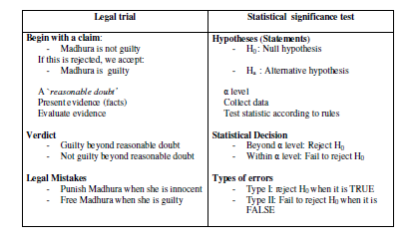

Slide 8
Non statistical Hypothesis Testing…
The critical concepts are these
There are two hypotheses, the null and the alternative hypotheses.
The procedure begins with the assumption that the null hypothesis is true.
The null hypothesis (H₀) will always state that the parameter equals the value specified in the alternative hypothesis (H_{a})
The goal is to determine whether there is enough evidence to infer that the alternative hypothesis is true.
There are two possible decisions:
Conclude that there is enough evidence to support the alternative hypothesis.
Conclude that there is not enough evidence to support the alternative hypothesis.

Slide 9
 | Decision
 | Accept H₀ | Reject H₀
H₀ (True) | Correct Decision | Type I error α error
H₀ (False) | Type II error β error | Correct Decision

Slide 10
Statement of Hypothesis testing in the context of Statistics
Generally, in hypothesis testing, one proceeds to collect evidence in support of null hypothesis Ho, on the assumption that the null hypothesis is true. Then, one can assign the probabilities to different possible results.
The level of significance.α
The level of significance is a criterion for judging and deciding a statement of null hypothesis, based on the probability of obtaining a measurement of samples, usually denoted by some percentage. For example, a significance level at 5% or less implies that H_{o} when assumed as true, is rejected. This is because the experimental evidence has a less than 0.05 probability of occurrence. As the significance level is the maximum value of the probability of rejecting H_{o}, it is set by users in advance

Slide 11
Decision rule or test of hypothesis:
The decision rule is a rule of the test according to which either Ho is accepted or rejected. Acceptance of H_{o} is the rejection of Ha and rejection of Ho is the acceptance of H_{a}. In the hypothesis testing, the probability P of obtaining an outcome is considered assuming that the null hypothesis is true. Usually, if the probability of obtaining the parameter is less than 5% when the null hypothesis is true, the decision is to reject the null hypothesis.

Slide 12
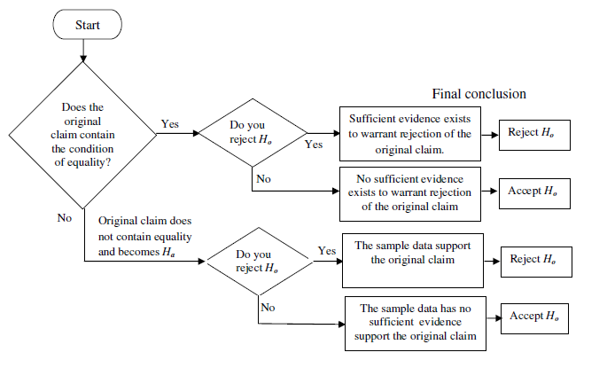

Slide 13
Two-tailed and one-tailed test
A two-tailed test is a hypothesis testing where the null hypothesis is rejected and usually denoted by the symbol ≠. In a two-tailed test, two rejection regions, one on each tail of the distribution curve, is possible. Symbolically, the two-tailed test is appropriately described by a set of equations given by,
H_{o} : μ = μ H_{o}
H_{a} : μ ≠ μ H_{o}
In term of standardised normal distribution, the acceptance region A : |z| ≤ 1:96 and rejection region R : |z| ≥ 1:96, where

Slide 14
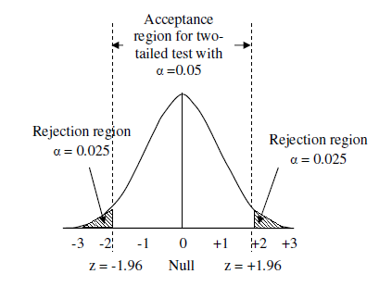
If the significance level is 5% and the two-tailed test is applied, the probability of the rejection area is α/2, that is, 0.05 is equally split on both tails of the curve as 0.05/2 = 0.025.

Slide 15
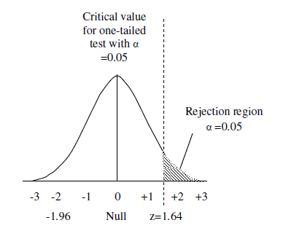
One tailed test
The schematic diagram of one-tailed test with a tail in the right hand direction. Similarly the tail can be on the left hand direction.

Slide 16
In parametric statistics, the information about the distribution of the population is known and is based on a fixed set of parameters. In nonparametric statistics, the information about the distribution of a population is unknown, and the parameters are not fixed, which makes is necessary to test the hypothesis for the population.
Parametric tests : z or t test or chi-test
z = z-score = a critical factor representing probability in terms of Standard Deviation (for sampling Standard Error) (valid for normal distribution) (critical value)
t = t-score = a factor representing probability in terms of standard deviation (or Std. Error) (valid for t distribution) (critical value)
α = (100% - confidence level)

Slide 17
Z-score
A z-score is a critical factor, indicating how many standard deviation (standard error for sampling) away from the mean a value should be to observe a particular (cumulative) probability.
There is a relationship between z-score and the value of the random variable over
Since the z-score is a measure of distance from the mean in terms of Standard Deviation (Standard Error for sampling), it provides us with information that a cumulative probability could not. For example, the larger z-score the unusual is the observation.

Slide 18
Z- Score: General definition
A z-score is the number of standard deviations that a raw score x, is above or below the mean .
A raw score x taken from a population is converted to a standardized z-score by the formula

Slide 19
Hypothesis test of mean: Procedure
(1) Population normal, population infinite, sample size may be large or small but variance of population is known, H_{a} may be one sided or two sided. In such situation z-test is used as,
(2) Population normal, population finite, sample size may be large or small but variance of population is known, H_{a} may be one sided or two sided. In such situation z-test is used as,

Slide 20
(3) Population normal, population infinite, sample size small but variance of population is unknown, H_{a} may be one sided or two sided. In such situation t-test is used as,
(4) Population normal, population finite, sample size small but variance of population is unknown, H_{a} may be one sided or two sided. In such situation t-test is used with a finite population multiplier

Slide 21
(5) Population is not normal, sample size large but variance of population is unknown or known, H_{a} may be one sided or two sided. In such situation z-test is used as, ( can be corrected with the population multiplier if population is finite as in (2))

Slide 22
Mean height of 400 students=67.47 inch. Can it be regarded as a sample of large population with mean 67.39 inch with standard deviation 1.30 inch? Test at 5% significance level.
Calculate z
For normal distribution, Rejection regions at 5% level of significance
R:z = 1.96 (given). As the observed value of 1.231 is less than 1.96, H₀ is accepted.

Slide 23
A tea stall has sales average 500 cups/day. Now a bus stand has come up nearby and sales for next 12 days are 550,570,490,615,505,580,570,460,600,580,530,526.
Can we conclude that the sales have increased. Given 5% significance level, REJECTION R:t>1.79
Null hypothesis
Alternate hypothesis
Population standard deviation is not known and the sample size is small, therefore we apply t –test.
Therefore at t=3.55, H₀ is rejected and H_{a} stands or the sales have increased

Slide 24
Hypothesis testing for difference between means
Applied to know whether two populations are alike or not (example: whether female workers earn less than men worker?
Case 1: Population variances are known or sample are large

Slide 25
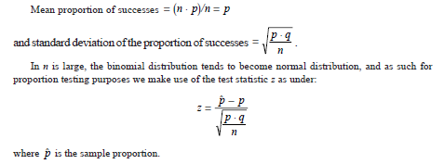
Hypothesis testing of proportion
Sampling distribution takes the form of binomial probability distribution whose mean is n.p and standard deviation is

Slide 26
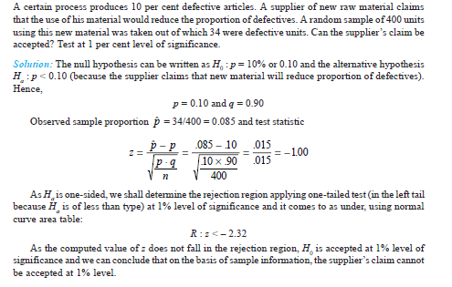

Slide 27
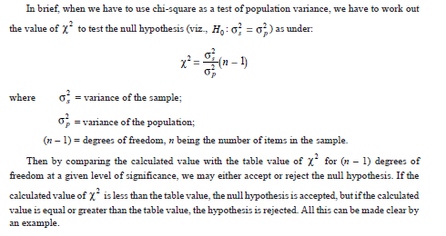
Chi square test

Slide 28
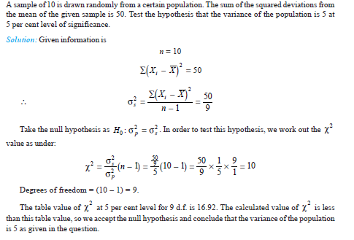

Slide 29
chi square non parametric test
A die is thrown 60 time with the following results
Face | 1 | 2 | 3 | 4 | 5 | 6 | Total
Frequency | 6 | 10 | 8 | 13 | 11 | 12 | 60
Are the data consistent with the hypothesis that the die is unbiased?
Given for 5 degree of freedom at 1% confidence level,
Null hypothesis is “die is unbiased”. Then the probability of each face is 1/6, and the expected frequencies is 60x1/6= 10 each.
Expected frequency | 10 | 10 | 10 | 10 | 10 | 10 | Total
Observed Frequency | 6 | 10 | 8 | 13 | 11 | 12 | 60
 | 16 | 0 | 4 | 9 | 1 | 4
Since the observed data 3.4 is less than given value 15.09 at ( 0.01 for 5 degree of freedom) we cannot reject the null hypothesis at 1% level of significant. So the conclusion is that the data is in agreement with the hypothesis of a unbiased die

